Slide 1
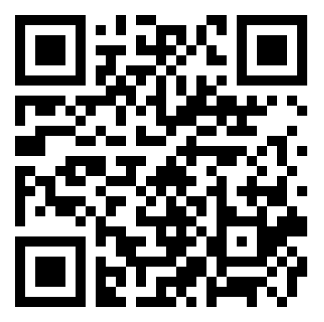
NativeScript Hackathon! [Dimo Dimov (Kendo UI) Burke Holland (DevRel) Deyan Ginev (NativeScript) Bozhidar Ivanchev (WebForms) Byulent Karaahmed (NativeScript) Georgi Krustev (Kendo UI) Jen Looper (DevRel) <-that’s me Ivana Maldonado (Marketing) Merrill Turner (Marketing) ]
Start the install NOW

Slide 2




6:30pm – 9:30pm Free pizza, drinks and dessert

Slide 3




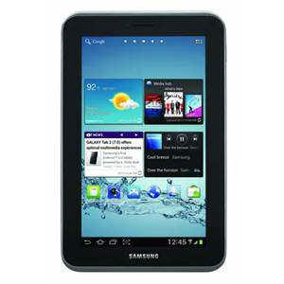
Prizes every 20 minutes!

Slide 4

Grand Prize
Sony PS4 Star Wars Battlefront edition

Slide 5

How’s it work?
Collect raffle tickets for the prize drawings
Complete the set up
Complete a module
Find a bug (gasp!)
Ask a really great question
Just raise your hand when you’ve done one of these and we’ll come around with a ticket for you.
Prize drawings will be held every 20 minutes!

Slide 6


What about the PS4?
Patience grasshopper…
Let us know when you’ve
completed the entire tutorial.
We’ll give you a blue Grand Prize raffle ticket.
We’ll mail the prize as soon as it’s available,
on November 17th.

Slide 7

Prize #1
Drawing will be held at 7:20pm

Slide 8

Prize #2
Drawing will be held at 7:40pm

Slide 9

Prize #3
Drawing will be held at 8:00pm

Slide 10

Prize #4
Drawing will be held at 8:20pm

Slide 11
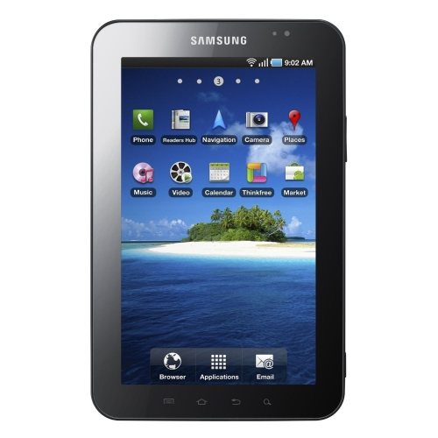
Prize # 5
Drawing will be held at 8:40pm

Slide 12

And the Grand Prize
Drawing will be held at 9:00pm
NOTE: Prize is not yet available. We will ship it to the winner once it hits the market.

Slide 13
While I talk, start your installs
Mac and PC installation guides here:

Slide 14


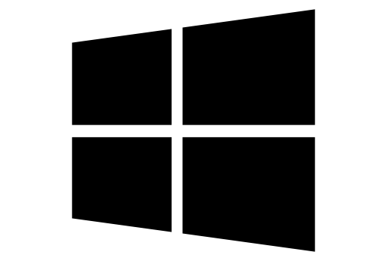
What is NativeScript?
A runtime for building and running native iOS, Android, and (soon) Windows Phone apps with a single, JavaScript code base

Slide 15
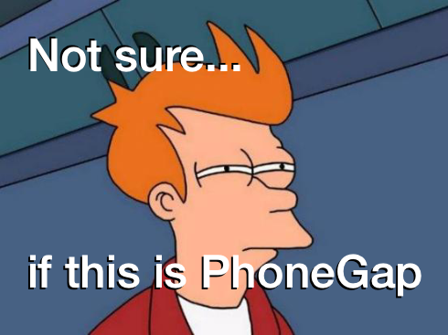

Slide 16
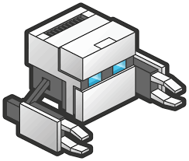
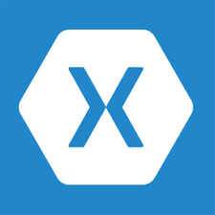


!=
!=
No DOM
No cross compilation
!=
Direct access to native APIs in JS

Slide 17
Why NativeScript?
Skills reuse
Standards-based JavaScript (optionally TypeScript), CSS, XML
Code reuse
npm modules, 3rd-party iOS and Android libraries
Easily use native APIs
No wrappers to access native APIs
Use native UI elements
Open source!

Slide 18
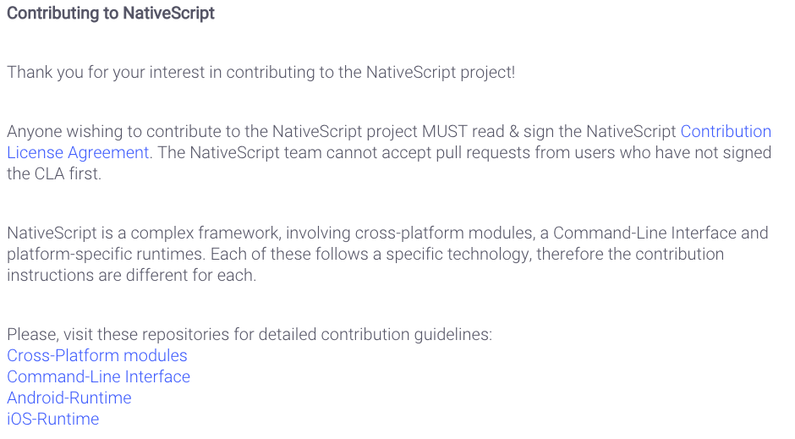
Contribute! (nativescript.org/contribute)

Slide 19





Bridge

Slide 20
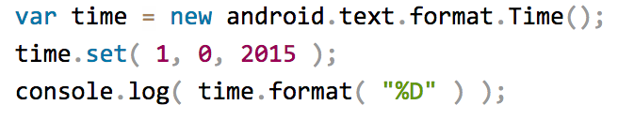
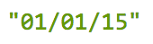
NativeScript Android example
Output:
Notes:
I'll give your brain a minute or two to parse this, because yes, this JavaScript code instantiates a Java android.text.format.Time() object, calls its set() method, then logs the return value of its format() method, which is the string "01/01/15".

Slide 21
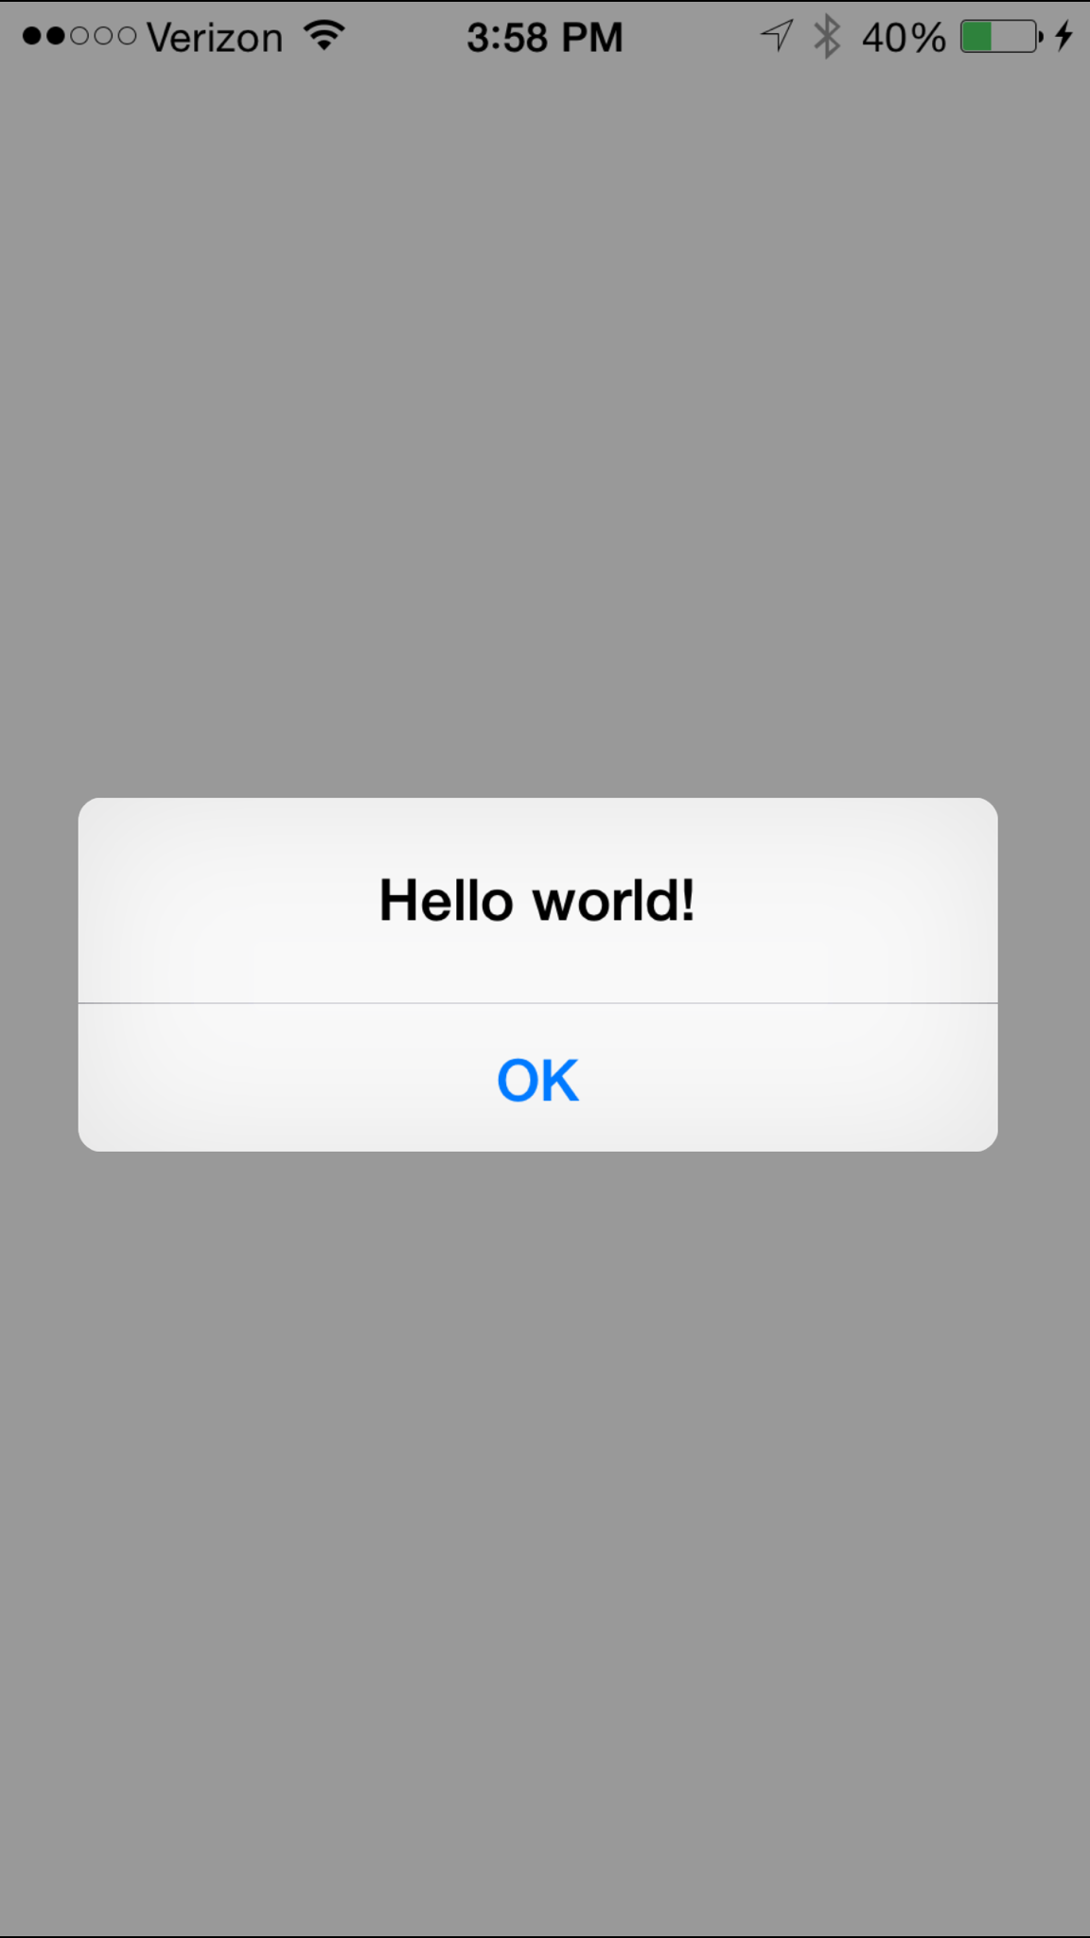
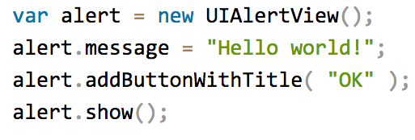
NativeScript iOS example
Notes:
This JavaScript code instantiates an Objective-C UIAlertView class, sets its message property, and then calls its addButtonWithTitle() and show() methods. When you run a NativeScript iOS app with this code you'll see the alert below:

Slide 22

How does this work?

Slide 23
NativeScript and JS VMs
NativeScript runs JavaScript on a JavaScript VM
JavaScriptCore on iOS
V8 on Android

Slide 24
Runs on V8
Runs on JavaScriptCore

Slide 25
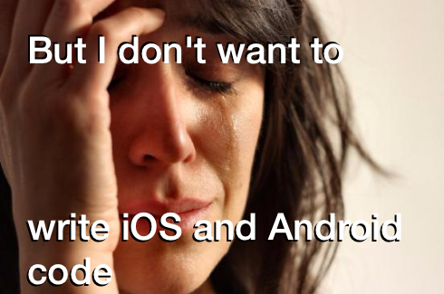

Slide 26
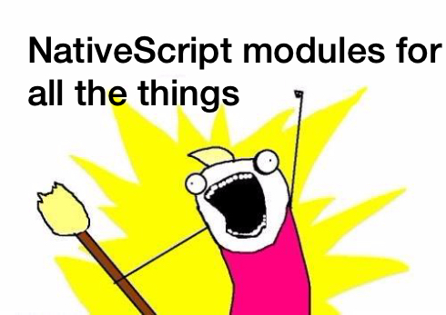

Slide 27
NativeScript modules
NativeScript-provided modules that provide cross-platform functionality.
There are dozens of them and they’re easy to write yourself.
NativeScript modules follow Node module’s conventions (CommonJS).

Slide 28
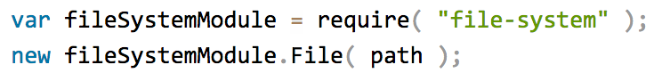
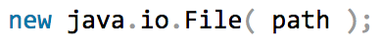
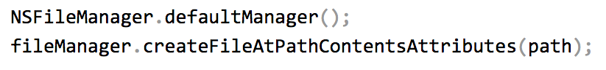
NativeScript file module
Notes:
So by requiring or including the file-system module, you have access to native Android methods of handling the file system as well as native iOS methods of storing files.

Slide 29
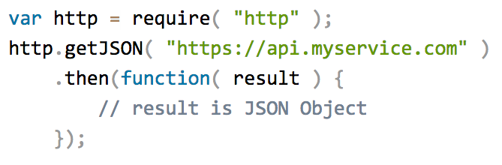
HTTP module example
Notes:
Another module – http. A great way to leverage REST apis to handle your data tier

Slide 30
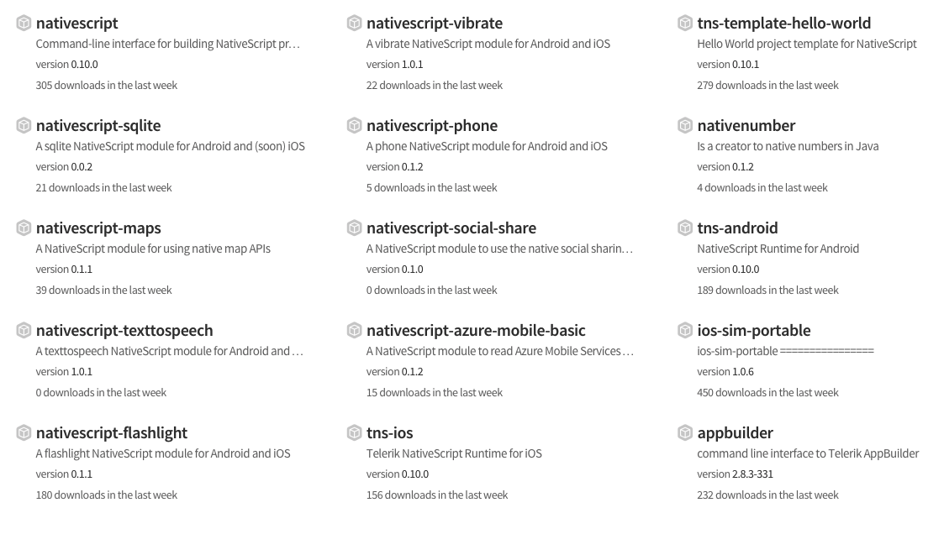
Community modules
https://www.npmjs.com/search?q=nativescript

Slide 31

But how do I turn this into an app?

Slide 32

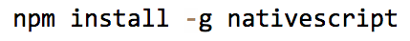
Two ways to use NativeScript
1)
2)

Slide 33
NativeScript CLI
Free and open source
https://github.com/nativescript/nativescript-cli

Slide 34
NativeScript CLI requirements
https://github.com/nativescript/nativescript-cli#system-requirements
JDK, Apache Ant, Android SDK
Xcode, Xcode CLI tools, iOS SDK

Slide 35
Let’s get started!
Go to the Getting Started Guide
and start building!
http://docs.nativescript.org/getting-started
RAISE YOUR HAND when you complete a chapter, have a problem, etc

